Slide 1



DX Ball:
C Program Showcase
Welcome to our deep dive into the creation of a classic Brick Breaker game using the C programming language. Over the next 10 cards, we'll explore the key components, code structure, collision detection, game state management, and visual representation that bring this timeless arcade game to life. Let's dive in and uncover the inner workings of this beloved title!

Slide 2

DX Ball:
C Program Showcase
Welcome to the world of classic arcade nostalgia, where a tiny ball holds the power to shatter bricks and egos alike! This presentation dives into the making of a simple yet addictive DX Ball game using C. With a bouncing ball, a trusty paddle, and a whole lot of bricks begging to be destroyed, this project showcases the art of combining logic, creativity, and a dash of frustration. Let’s break it down—brick by brick! 🎮

Slide 3


Purpose
This DX Ball game is supposed to show how some basic C programming concepts like loops, conditionals, and functions can be put together to make a fun and interactive experience. It also serves as an introduction to game mechanics like collision detection, real-time input handling, and structured design.
Gameplay Description
In this game, the player controls a paddle at the bottom of the screen to bounce a ball upwards, breaking bricks arranged at the top. Each brick broken earns points, and the game ends when the player runs out of lives (when the ball misses the paddle). With every bounce and collision, the ball changes direction, challenging the player’s reflexes and precision. Simple, addictive, and a great throwback to classic arcade fun!

Slide 4
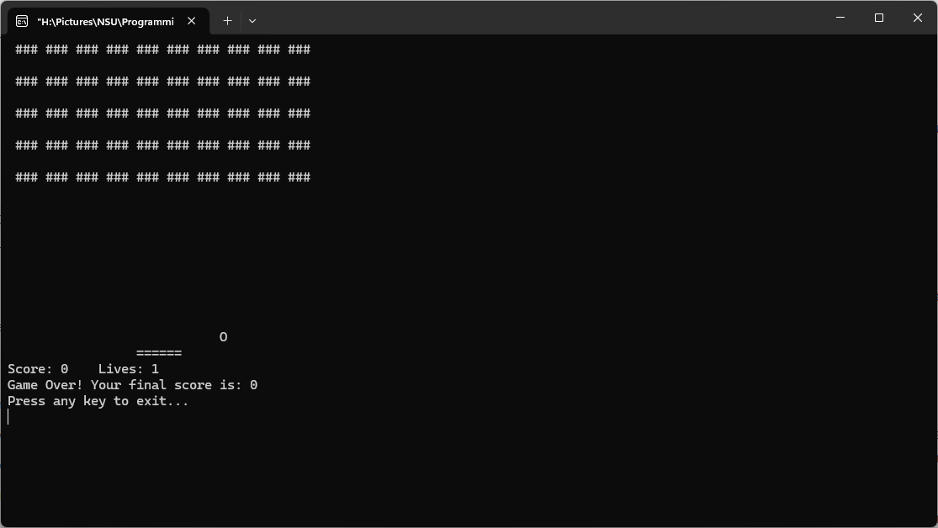

Slide 5





PURPOSE

Slide 6
Initialization:
The game starts by setting up bricks using the init_bricks() function, positioning the ball and paddle, and initializing game variables like score and lives.

Slide 7
Game Loop:
The main game operates in an infinite loop that continuously calls three key functions:
draw(): Renders the game board with bricks, paddle, ball, and displays score and lives.
input(): Captures player input (a to move left, d to move right) to control the paddle.
update(): Updates the ball’s position, checks for collisions (with walls, paddle, bricks), and manages scoring and lives.

Slide 8
Collision Detection:
The ball’s movement is adjusted upon hitting walls, bricks, or the paddle. Hitting a brick removes it, increases the score, and changes the ball’s direction.

Slide 9
Game Over Handling:
If the ball falls below the paddle, the player loses a life. The game ends when all lives are lost, displaying the final score and an exit prompt.

Slide 10

Logic and Features

Slide 11

Score It Like a Pro
Lives on the Line
Brick-Busting Brilliance
Paddle Power
The ball has a mind of its own! It bounces off walls, smashes bricks, and even bounces back from the paddle, all thanks to some neat direction-flipping math.
Collision Chaos
Dynamic Gameplay
Score It Like a Pro
Lives on the Line

Slide 12

Dynamic Gameplay
Score It Like a Pro
Lives on the Line
Brick-Busting Brilliance
Your paddle is your savior—move it left (a) or right (d) to keep the ball from falling into the abyss (a.k.a. game over).
Paddle Power
Collision Chaos
Dynamic Gameplay
Score It Like a Pro

Slide 13

Collison Chaos
Dynamic Gameplay
Score It Like a Pro
Lives on the Line
Bricks vanish with a satisfying “pop” (okay, it’s just a space character), scoring you points and upping your bragging rights.
Brick-Bustling Brilliance
Paddle Power
Collison Chaos
Dynamic Gameplay

Slide 14

Paddle Power
Collison Chaos
Dynamic Gameplay
Score it Like a Pro
You start with 3 precious lives. Miss the ball? Oops, down one life! Lose them all, and it’s “Game Over,” with a consolation prize of your final score.
Lives on the Line
Brick-Bustling Brilliance
Paddle Power
Collison Chaos

Slide 15
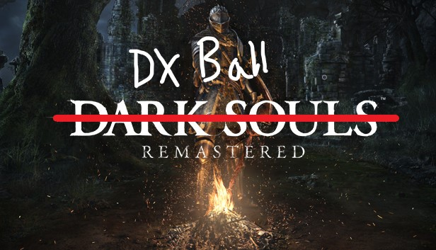
Brick-Bustling Brilliance
Paddle Power
Collison Chaos
Dynamic Gameplay
Every smashed brick earns you 10 points, and no, there’s no bonus for style—but we still cheer you on!
Score it Like a Pro
Lives on the Line
Brick-Bustling Brilliance
Paddle Power

Slide 16
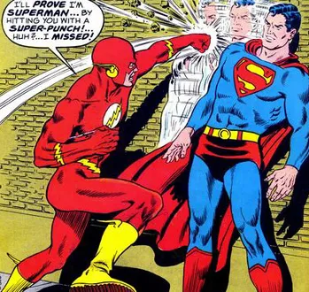
Lives on the Line
Brick-Bustling Brilliance
Paddle Power
Collision Chaos
The game speeds along as the ball ricochets unpredictably, keeping your reflexes sharp and your keyboard clicking.
Dynamic Gameplay
Score It Like a Pro
Lives on the Line
Brick-Bustling Brilliance

Slide 17
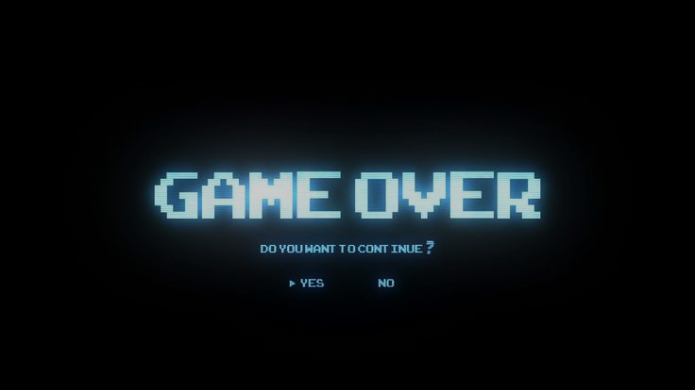
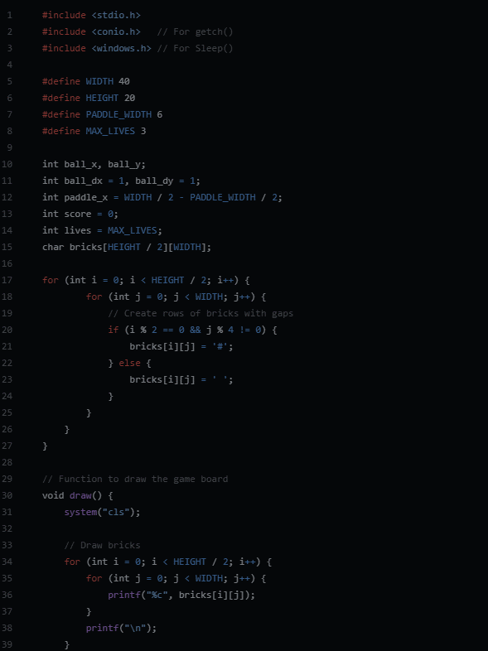
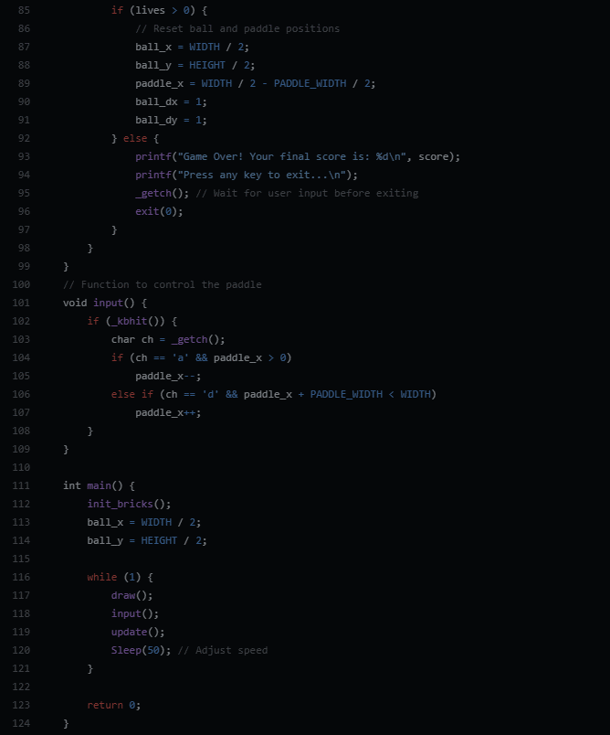
Conclusion:
The DX Ball game showcases how basic C programming concepts can create an engaging and interactive experience. It combines logic, real-time input handling, and structured design to deliver a fun project while enhancing programming skills. A simple yet effective example of learning through play!

Slide 18

Future Scope
Power-Ups: Introduce features like multi-ball, extended paddles, or brick-destroying lasers for added excitement.
Levels: Add difficulty progression with more challenging brick patterns or faster ball speeds.
Improved Graphics: Use libraries like SDL or OpenGL to replace text-based visuals with sleek graphics.
High Scores: Implement a leaderboard system to save and display top scores for competitive replayability.
Sound Effects: Add audio feedback for paddle hits, brick destruction, and game-over moments to enhance immersion.

Slide 19

Project made by
Sajid Hasan Abir
Md. Nayeem Ahmed
Irfan Bin Kamal
Mir Tausif Siam
Sources
ChatGPT "The C Programming Language" by Brian W. Kernighan and Dennis M. Ritchie – for foundational knowledge of C
Motivation
A few marks for presentation
_{THANK YOU}

